Slide 1

Wireless Metropolitan Area Network WMAN

Slide 2
WMAN and Wireless Networks
WWAN
802.20 (proposed)
WiMAX
New standard for
Fixed broadband
Wireless. Trying to do
for MAN what Wi-Fi
did for LAN.
WMAN
70 Mbps
~50 Km
802.16a/e
Wi-Fi®
Includes 802.11a/b/g.
Products must be
Approved for
Interoperability by the
Wi-Fi Alliance.
WiMAX: Worldwide Interoperability
for Microwave Access
Wi-Fi : Wireless Fidelity
WLAN
11-54 Mbps
~100m
802.11a/b/g
WPAN
~1.5 Mbps
<10 m
802.15.1 (Bluetooth)

Slide 3
Wireless Local Loop
Wired technologies responding to need for reliable, high-speed access by residential, business, and government subscribers ISDN, xDSL, cable modems
Increasing interest shown in competing wireless technologies for subscriber access
Wireless local loop (WLL)
  Narrowband – offers a replacement for existing telephony services
  Broadband – provides high-speed two-way voice and data service

Slide 4
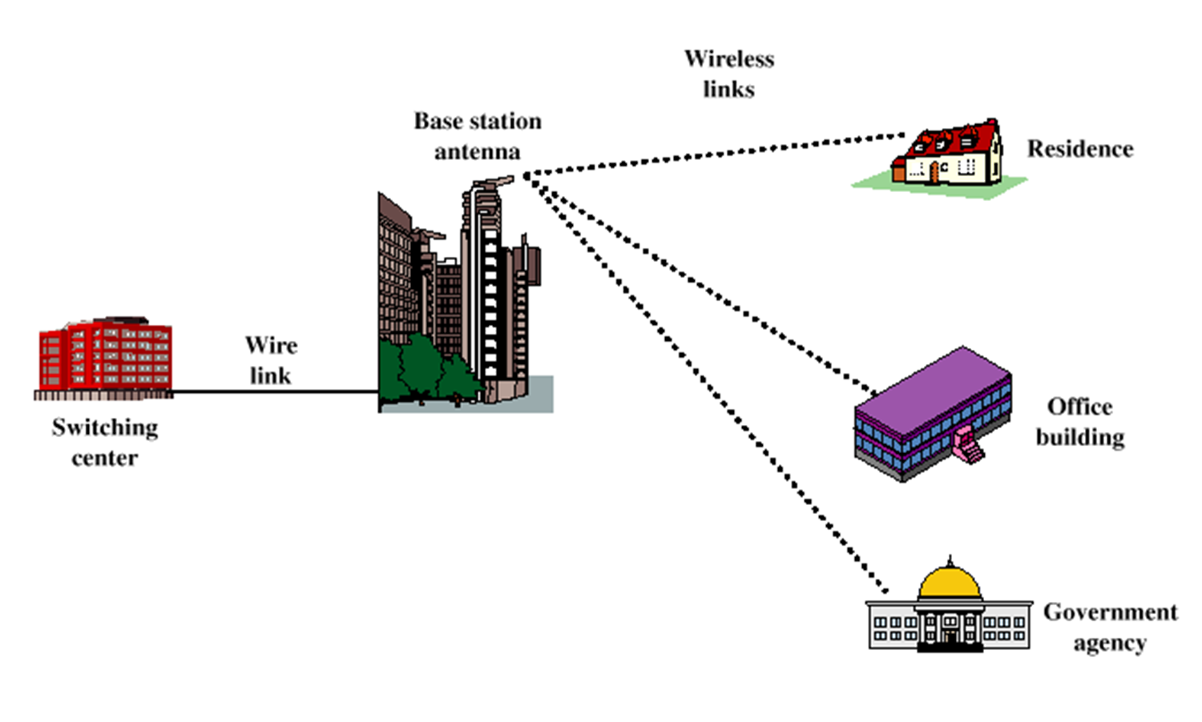

Slide 5
Advantages of WLL over Wired Approach
Cost – wireless systems are less expensive due to cost of cable installation that’s avoided
Installation time – WLL systems can be installed in a small fraction of the time required for a new wired system
Selective installation – radio units installed for subscribers who want service at a given time
  With a wired system, cable is laid out in anticipation of serving every subscriber in a given area

Slide 6
WiMAX
WiMAX (Worldwide Interoperability for Microwave Access) (IEEE 802.16) technology offers:
  High speed of broadband service
  Wireless rather than wired access
  Broad coverage like cell phones
  WiMAX coverage; 50km (radius)
  WiMAX speed; 70 Mbps.

Slide 7
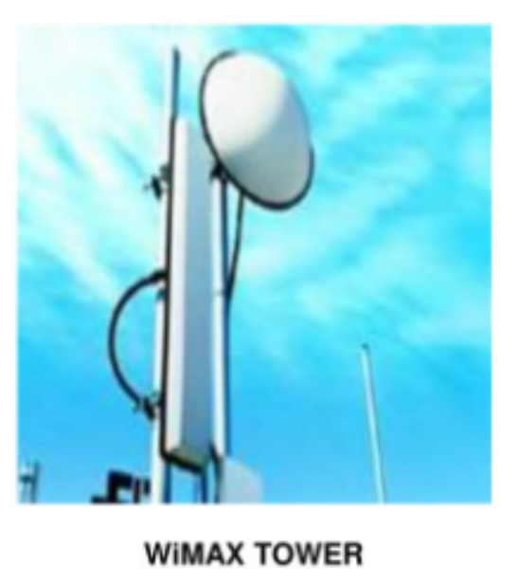
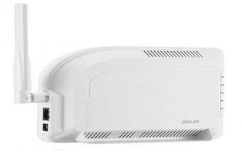
WiMAX
WiMAX would operate similar to Wi-Fi but at a higher speeds, over greater distances, and for a greater number of users.
WiMAX system consists of two parts:
  WiMAX Tower; it is similar to cell phone tower with large coverage area (~8.000 square km).
  WiMAX Receiver ; it could be a small box or PCMCIA card.

Slide 8
WiMAX
WiMAX has two modes:
  Non line-of-sight; where a small antenna on a computer connects to the WiMAX tower. It uses a lower frequency rang 2 GHz – 11GHz. (802.16a)
  Line-of-sight; where a fixed dish antenna points straight at the WiMAX tower. It uses higher frequency 10 GHz up to 66 GHz.

Slide 9
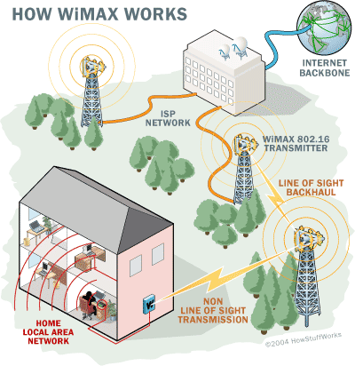
WiMAX

Slide 10
802.16 Standards Development
Use wireless links with microwave
Use licensed spectrum
Are metropolitan in scale
Provide public network service to fee-paying customers
Use point-to-multipoint architecture with stationary rooftop or tower-mounted antennas

Slide 11
802.16 Standards Development
Provide efficient transport of heterogeneous traffic supporting quality of service (QoS)
Use wireless links with microwave or millimeter wave radios
Are capable of broadband transmissions (>2 Mbps)
Range - 30-mile (50-km) radius from base station
Speed - 70 megabits per second
Line-of-sight not needed between user and base station
Frequency bands - 2 to 11 GHz and 10 to 66 GHz (licensed and unlicensed bands)

Slide 12
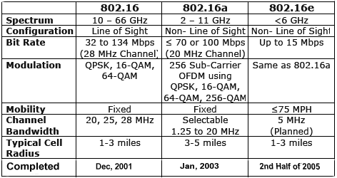
IEEE 802.16 Standards related to WiMAX

Slide 13
WiMAX QoS
QoS means successful delivery of high value services such as voice and video.
QoS measured parameters are : Latency, Jitter and Packet Loss
Prioritizing Traffic is one solution to provide QOS for time sensitive traffic such as VoIP and video
Arrange the following applications into prioritizing categories:
  FTP - Streaming Audio and Video
  VoIP -Data Transfer, Web Browsing

Slide 14
WiMAX Security
WiMAX systems were designed at the outset with robust security in mind. The standard includes state-of-the-art methods for ensuring user data privacy and preventing unauthorized access with additional protocol optimization for mobility.
Support For Privacy : User data is encrypted using cryptographic schemes. Both AES (Advanced Encryption Standard) and 3DES (Triple Data Encryption Standard) are supported with 128-bit or 256-bit key length

Slide 15
WiMAX Security
Authentication :WiMAX terminal devices come with built-in digital certificates that contain their public key and MAC address. WiMAX operators can use the certificates for device authentication and use a username/password or smart card authentication on top of it for user authentication.
The Privacy and Key Management Protocol Version 2 (PKMv2) is used for securely transferring keying material from the base station to the mobile station, periodically re-authorizing and refreshing the keys.

Slide 16
WiMAX Security
The integrity of over-the-air control messages is protected by using message digest schemes, such as AES-based Cipher-based message authentication codes “CMAC” or MD5-based HMAC.
To support fast handovers, WiMAX allows to use pre-authentication with a particular target BS to facilitate accelerated re-entry.

